Slide 1
SAT/ ACT Participation Rate Analysis
Jefferson
General Assembly DSI20

Slide 2
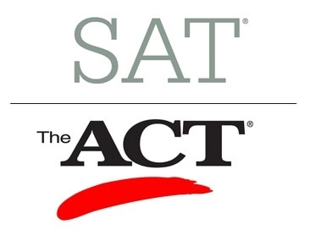
Problem Statement
To recommend of a way to allocate resources to improve SAT participation rate within the states.

Slide 3


1. Intro
ACT and SAT are the two most popular university admission test in the US. They share many similarities:
Subject being tested Math, Reading in both tests. ACT has Science and English subjects too.
Similar price point ACT costs $70, SAT costs $68*.
Available in all states All states provide the test with some provides free tests.

Slide 4
What is the distribution of participation rate of the tests?
Which test is
more popular?
Any trend?
Where is the data from?
SAT original data is available to download from (2017 SAT Suite of Assessments Annual Report)
While ACT Data can be obtained from act.org own website

Slide 5
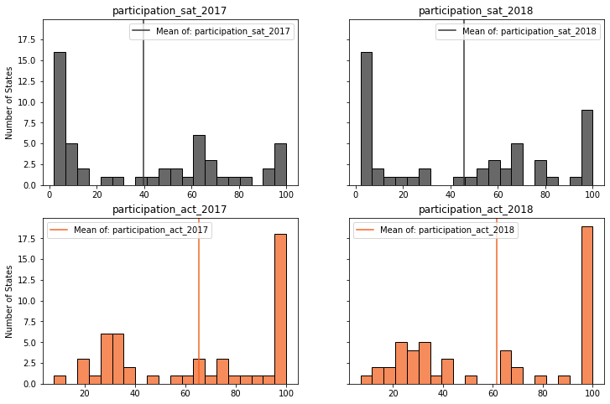
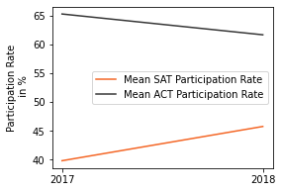
Participation Rate Distribution
ACT has a higher participation rate than SAT with clear bimodal distribution.
However, there is an improvement of SAT participation rate while opposite is true for ACT.

Slide 6
Is there any pattern here?
Or test popularity is totally random?
(or dare I say it if there is no pattern ;))

Slide 7
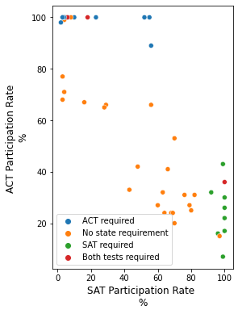
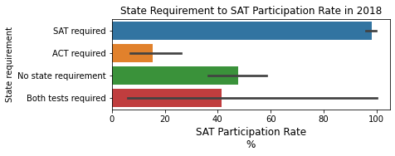
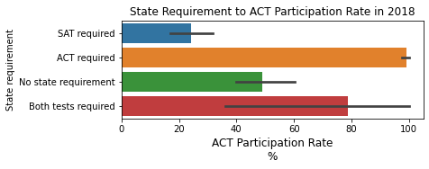
States Requirement and Participation Rate

Slide 8
What factor may relate to the test preference?
Is there any relation between state wealth and test preference?
Note
GDP per capita is used as a gauge of states wealth
States are divided into:
Top 25% (13 states)
Top 50% (12 states)
Bottom 50% (13 states)
Bottom 25% (13 states)

Slide 9
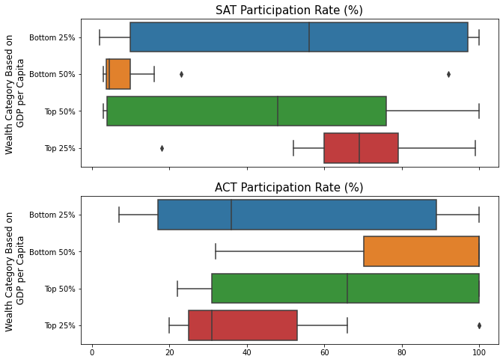
States Wealth and Participation Rates
Despite being equally popular on states within bottom 25% bracket, SAT is significantly less popular on the states within bottom 50% wealth bracket.
What if we include states requirement into the equation?

Slide 10
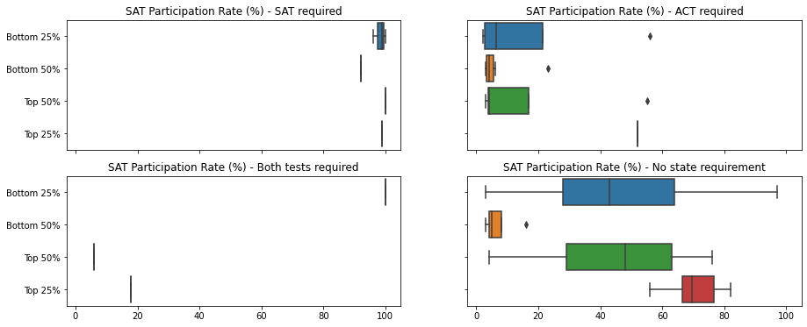
States Wealth and Requirement Effect
For states with only SAT requirement, SAT is the preferred choice regardless the wealth status.
For states with both SAT and ACT requirement, SAT is only preferred when state is less affluent.
For states with ACT requirement, SAT is significantly less popular if state is not at the Top 25%.
When there is no state requirement, SAT is significantly less popular especially within the Bottom 50% bracket
1
3
2
4

Slide 11
Hmm interesting
What should we do next then?
in case anyone forgets the problem statement:
To recommend of a way to allocate resources to improve SAT participation rate within the states.

Slide 12
Conclusion
Recommendation
In short,
Distribution Bimodal.
ACT is more popular, SAT is catching up
State Requirement Effect State requirement plays a huge role in determining test preference
Wealth Effect More affluent states prefers SAT
SAT is significantly less popular in poorer state without SAT requirement
- To focus on resources to less affluent state (bottom 50%) with no SAT requirement.
Case on point: New Mexico
Less affluent (bottom 50%)
High inequality (gini coefficient)
No SAT requirement
2018 SAT participation rate : 18%
Also,
to adjust SAT format to be more accessible and practical in the times of pandemic.

Slide 13
References
Template of Presentation by:
Made to Stick
Original Data:
SAT
ACT
GDP
Thanks for the help of mentors:
Jireh Tan
Ryan Chang
Zaini Chia

Slide 14
Appendices

Slide 15
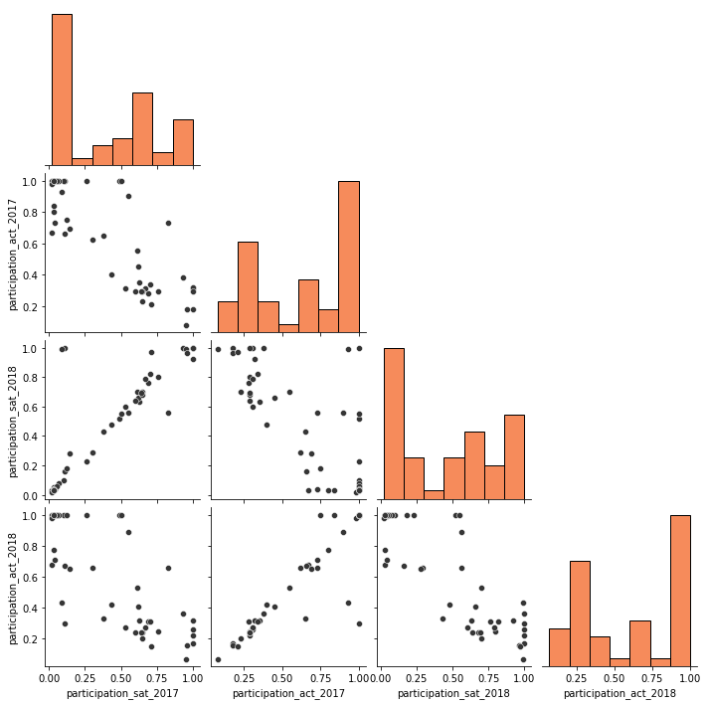

Slide 16
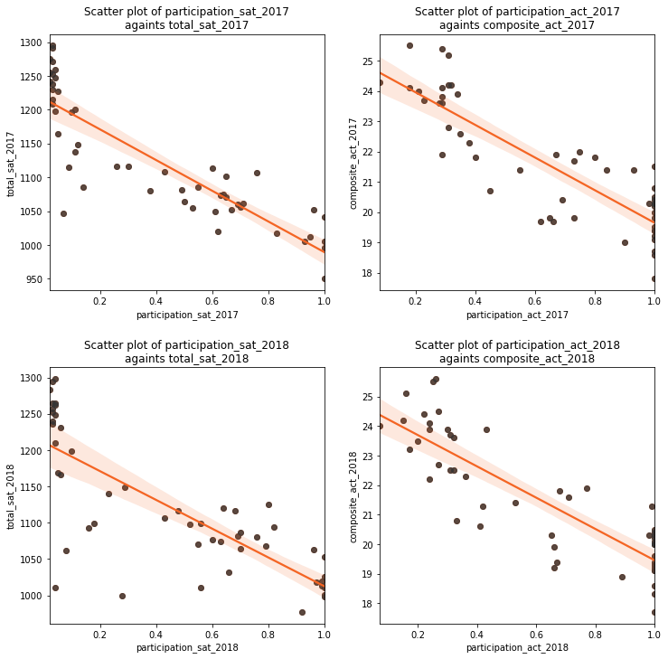

Slide 17
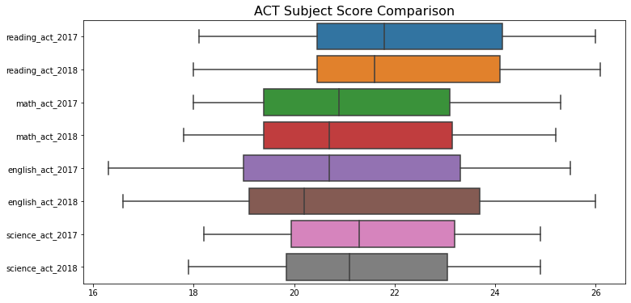

Slide 18
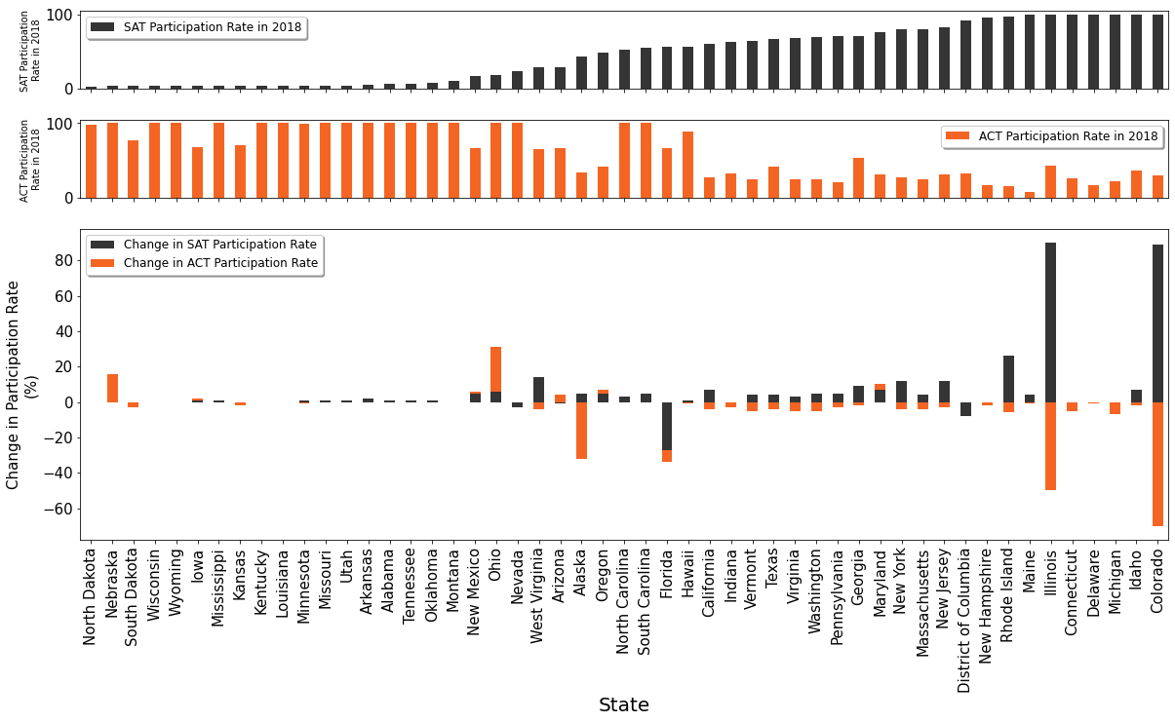

Slide 19
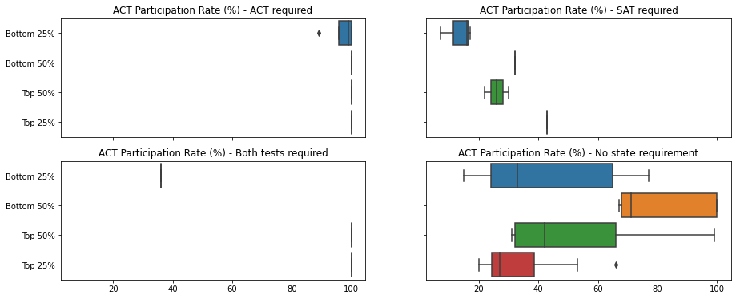

Slide 20
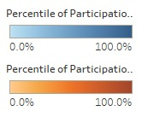
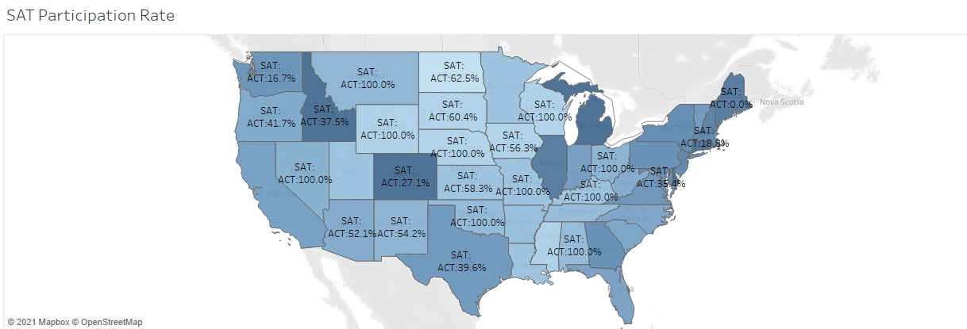

Slide 21
